Slide 1
Drug Over Dose Analysis

Slide 2
Introduction:
In the landscape of public health challenges, drug overdose incidents represent a pressing concern, necessitating a comprehensive understanding of the underlying trends and factors driving this crisis. The dataset at our disposal serves as a valuable resource for unraveling the complexities of drug overdose incidents, offering a structured framework for analysis and interpretation.

Slide 3
Content:
1. *INDICATOR*: This column likely represents the specific indicator or metric being measured or reported. It could be any quantitative or qualitative measure, such as population, income, employment rate,
.2. *PANEL*: The "PANEL" column might refer to a specific panel or group within the dataset. Panels are often used to organize and categorize data based on certain criteria or characteristics.
3. *PANEL_NUM*: This column may contain numerical identifiers corresponding to the panels mentioned in the "PANEL" column. Numerical identifiers are useful for data processing and analysis, especially when dealing with large datasets.
4. *UNIT*: The "UNIT" column indicates the unit of measurement associated with the data in the dataset. This could be units such as individuals, households, dollars, percentages, etc.
5. *UNIT_NUM*: Similar to the "PANEL_NUM" column, this column likely contains numerical identifiers corresponding to the units of measurement mentioned in the "UNIT" column.
6. *STUB_NAME*: The "STUB_NAME" column refers to the name of the stub, which typically represents a category or grouping of data in the dataset. Stubs are often used to organize data along one axis of a table or matrix.
7. *STUB_NAME_NUM*: This column likely contains numerical identifiers corresponding to the stub names mentioned in the "STUB_NAME" column. These numerical identifiers can facilitate data analysis and processing tasks.
8. *STUB_LABEL*: The "STUB_LABEL" column contains labels or descriptions associated with the stub names. These labels provide additional context or information about the categories represented by the stub names.
9. *STUB_LABEL_NUM*: Similar to the "STUB_NAME_NUM" column, this column contains numerical identifiers corresponding to the stub labels mentioned in the "STUB_LABEL" column.
10. *YEAR*: The "YEAR" column represents the specific year to which the data corresponds. This column is essential for temporal analysis and allows users to track changes over time.
11. *YEAR_NUM*: This column contains numerical identifiers corresponding to the years mentioned in the "YEAR" column. Numeric identifiers can aid in data manipulation and analysis tasks.
12. *AGE*: The "AGE" column likely refers to the age group or range to which the data pertains. Age groups are often used to segment and analyze data based on age demographics.
13. *AGE_NUM*: Similar to the "YEAR_NUM" column, this column contains numerical identifiers corresponding to the age groups mentioned in the "AGE" column.
14. *ESTIMATE*: The "ESTIMATE" column contains the estimated value or measurement for the indicator being reported. This column provides the primary data of interest for analysis and interpretation.

Slide 4
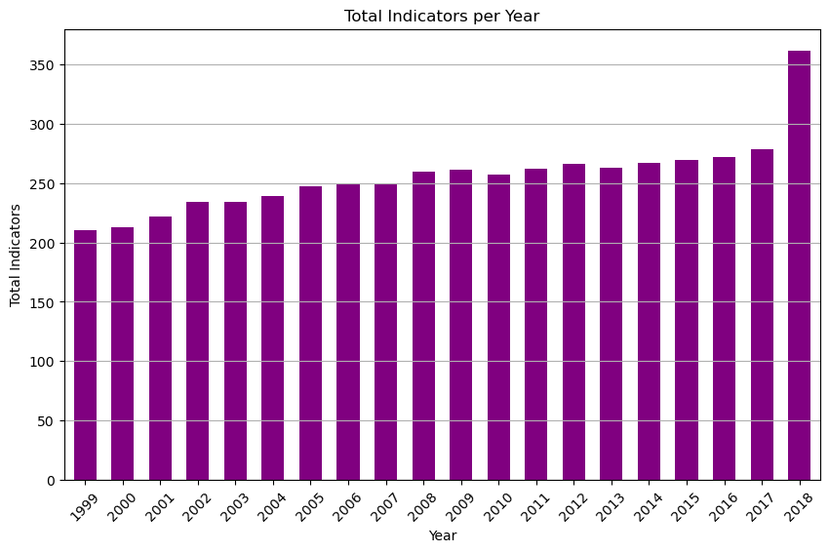
1)count occurrences of each indicator for each year

Slide 5
2)How many panels are there in the dataset?
Number of panels in the dataset: 6
All drug overdose deaths 1037
Drug overdose deaths involving any opioid 997
Drug overdose deaths involving natural and semisynthetic opioids 920
Drug overdose deaths involving other synthetic opioids (other than methadone) 736
Drug overdose deaths involving methadone 723
Drug overdose deaths involving heroin 704

Slide 6
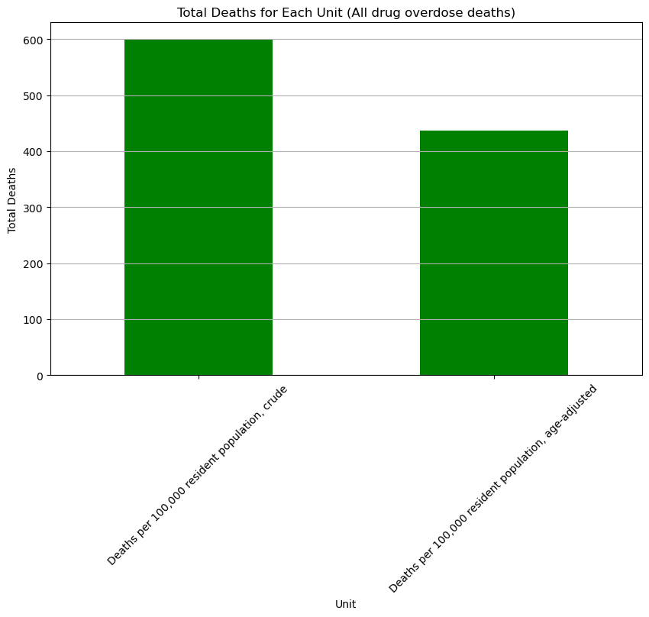
3)What is the distribution of total deaths for each unit within the 'All drug overdose deaths' panel?

Slide 7
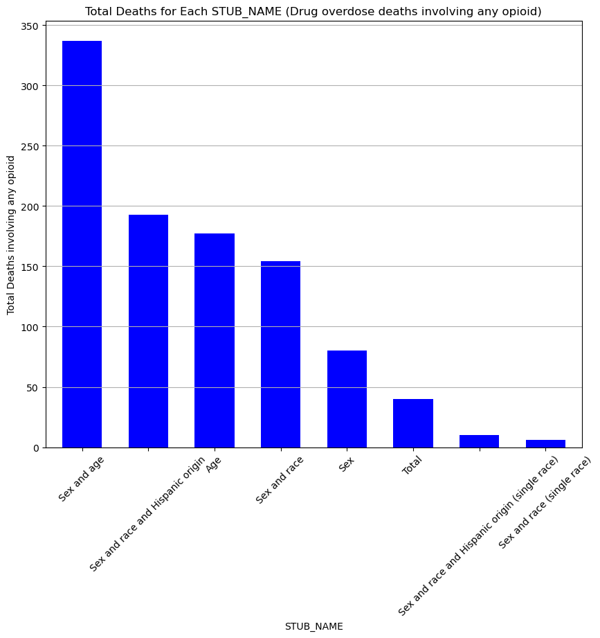
4)find out Total Deaths for Each STUB_NAME (Drug overdose deaths involving any opioid)

Slide 8
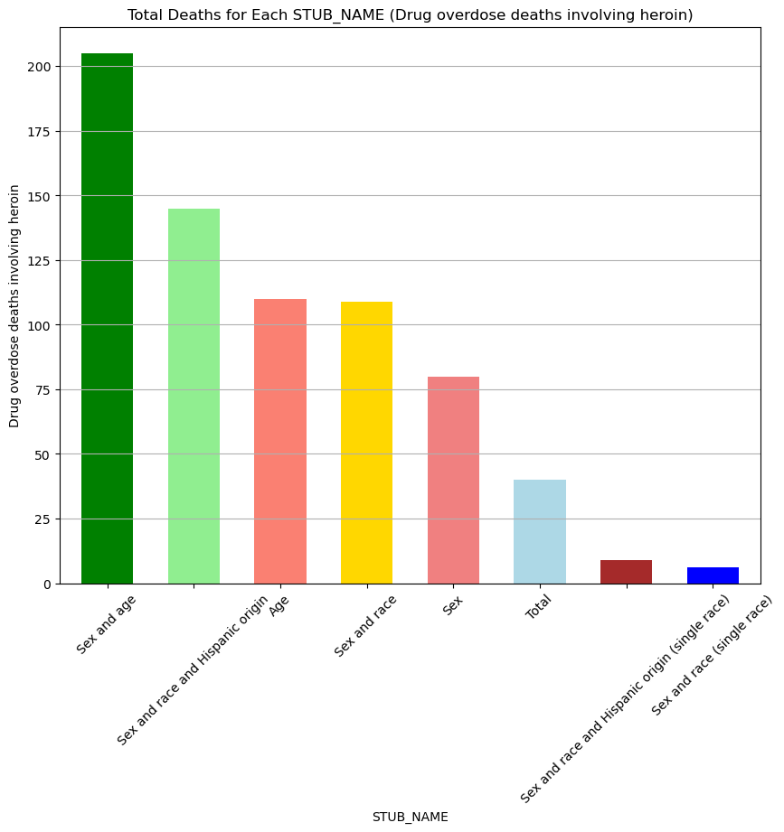
5)total deaths for each STUB_NAME within the 'Drug overdose deaths involving heroin' panel?

Slide 9
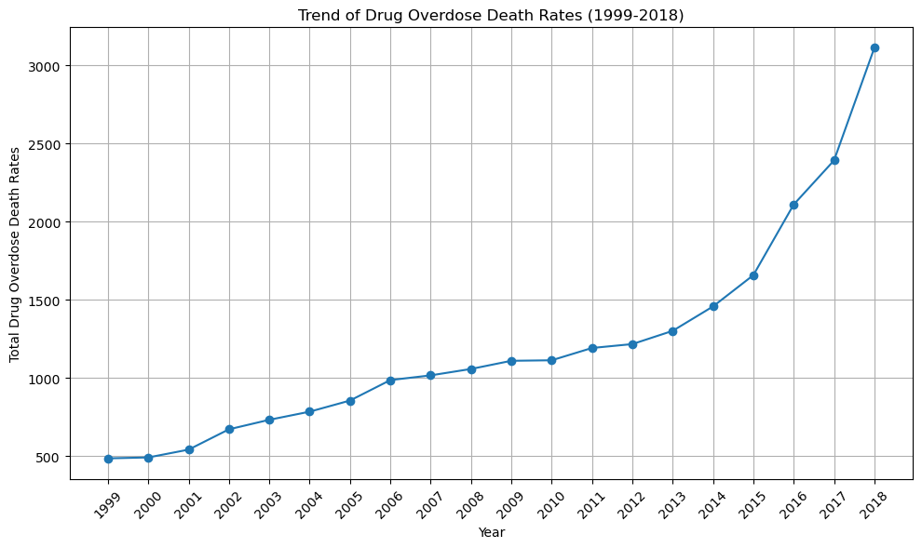
6)What is the trend in drug overdose death rates from 1999 to 2018?

Slide 10
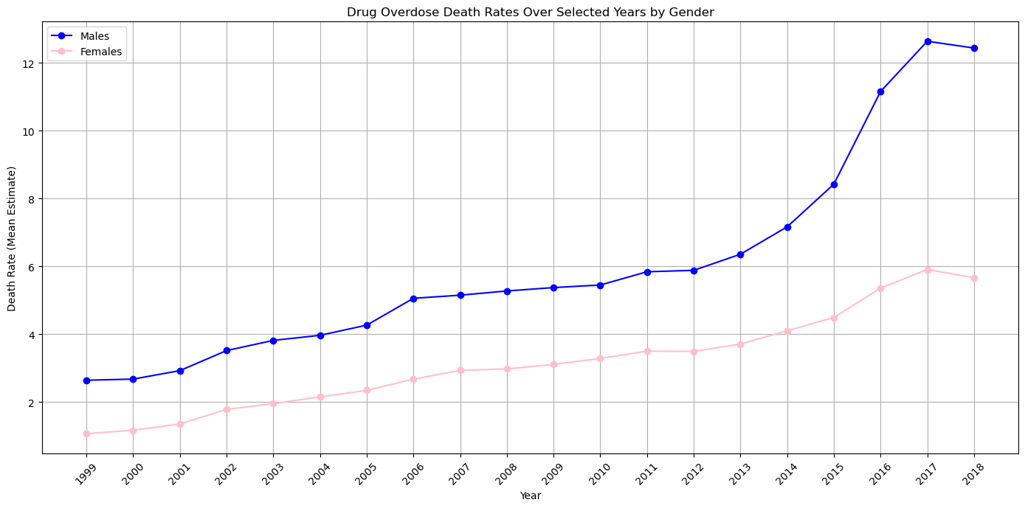
7)drug overdose death rates vary between males and females over the years?

Slide 11
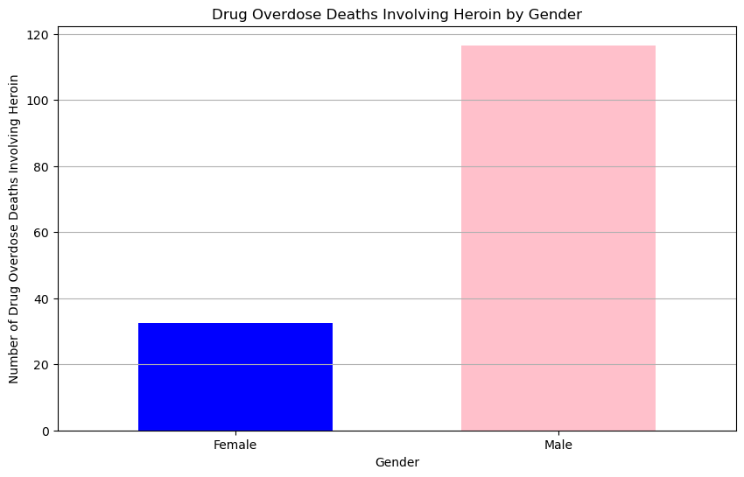
8)drug overdose death rates involving heroin differ between males and females?

Slide 12
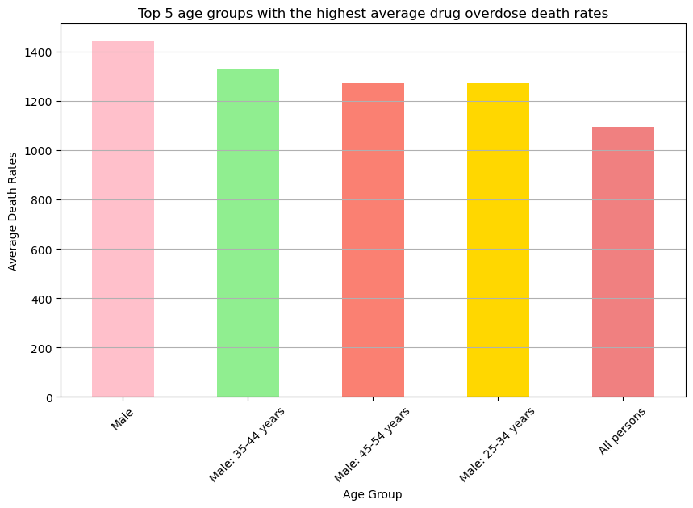
9)top 5 age group has consistently shown the highest drug overdose death rates?

Slide 13
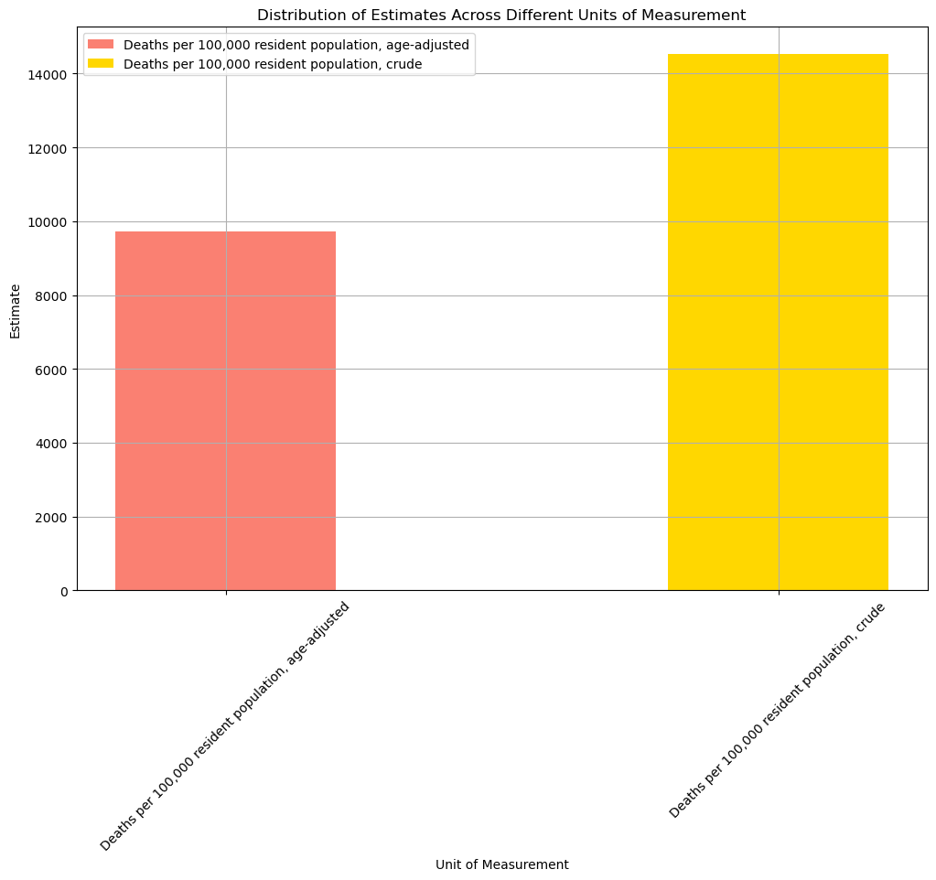
10)Distribution of Estimates Across Different Units of Measurement

Slide 14
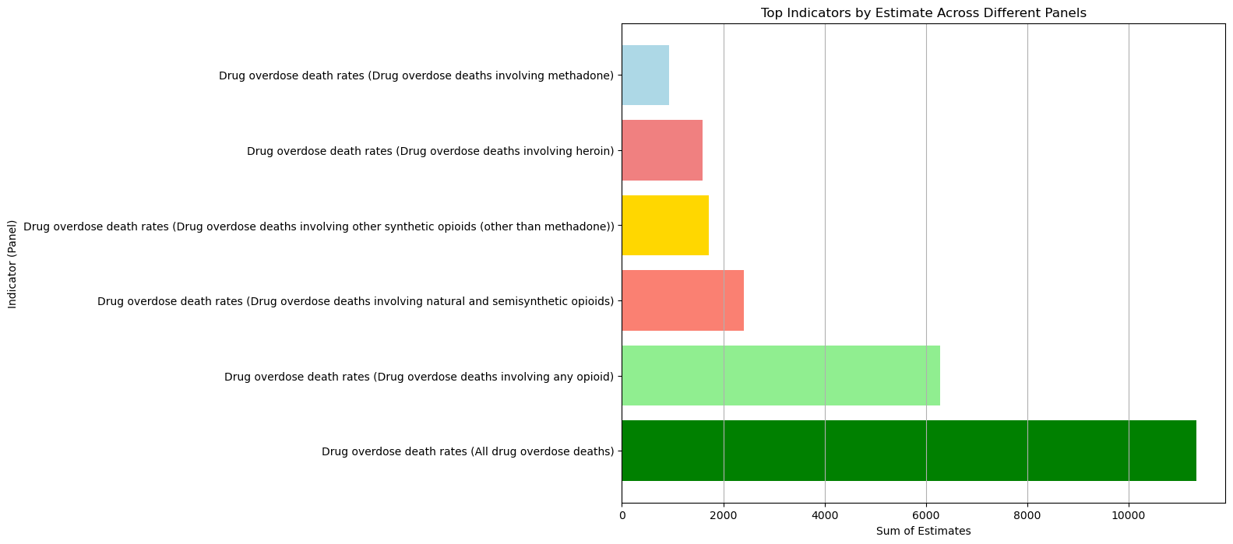
11)What are the top indicators by estimate, and how do they differ across different panels?

Slide 15
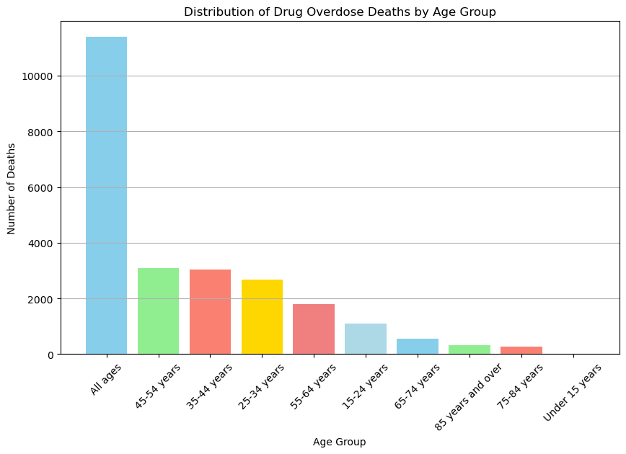
12)find out Drug Overdose Deaths by Age Group

